Slide 1


C# Azure Functions
Isolated process
Alex Drenea
Cloud Solution Architect
Microsoft

Slide 2
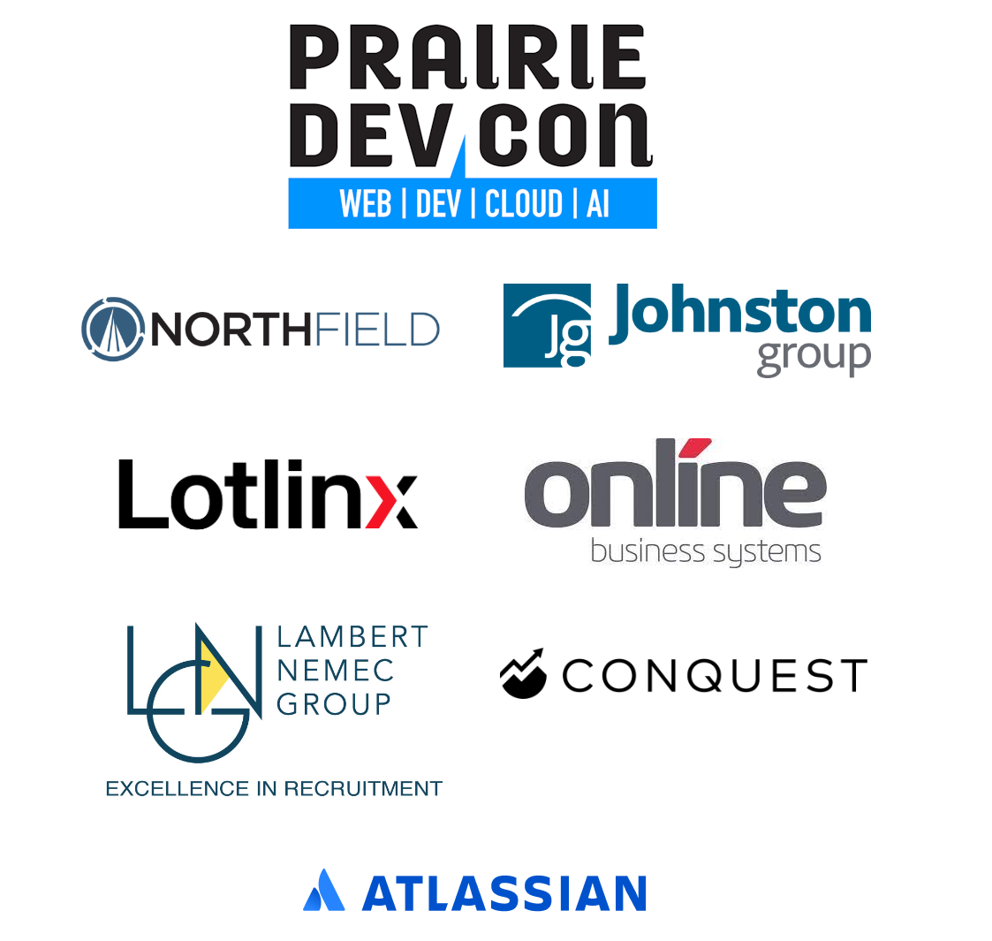

Slide 3
Awesome Demo

Slide 4
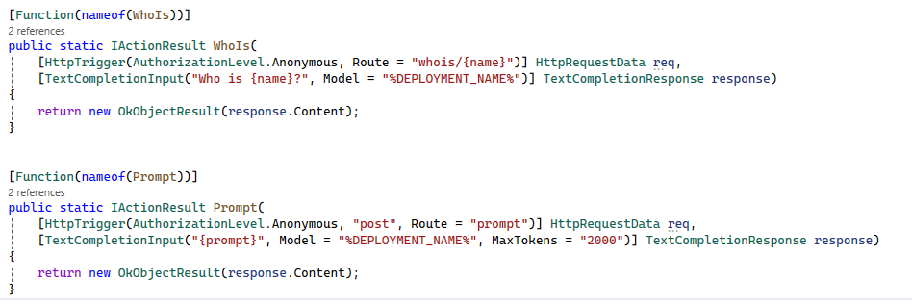
How many lines of code ?
Notes:
How many lines of code was that?
1 line of code!!!!

Slide 5
OpenAI Extension For Function App plug
Preview, launched Jul 2024
Azure OpenAI Extension for Function Apps
Simplify OpenAI integration with built-in triggers and bindings.
Chat/Assistant
Completions
Embeddings

Slide 6

Run code when events occur
Event-driven scaling
No infrastructure management
Consumption pricing with free grant
Azure Functions
Notes:
Quick overview of Azure Functions
- Run code based on an event (http, storage account, cosmos db, event grid, service bus and many more)
- Don’t have to worry about infrastructure, that’s handled for you.
- It will scale from not running to 1000s of instances and back down as needed.
- As it scales you only pay for what you use.

Slide 7







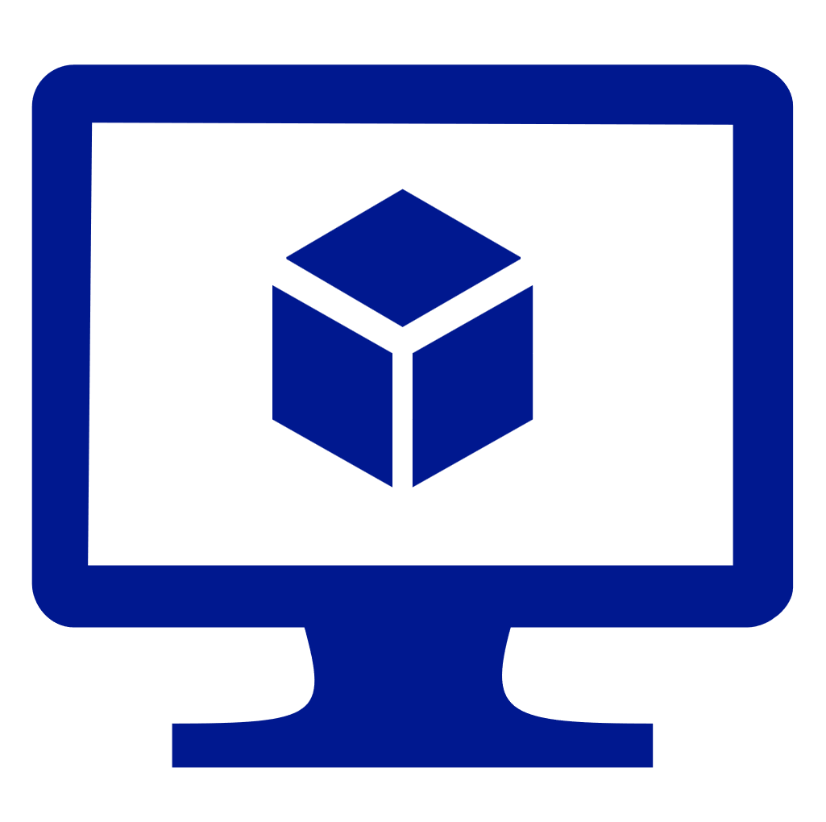



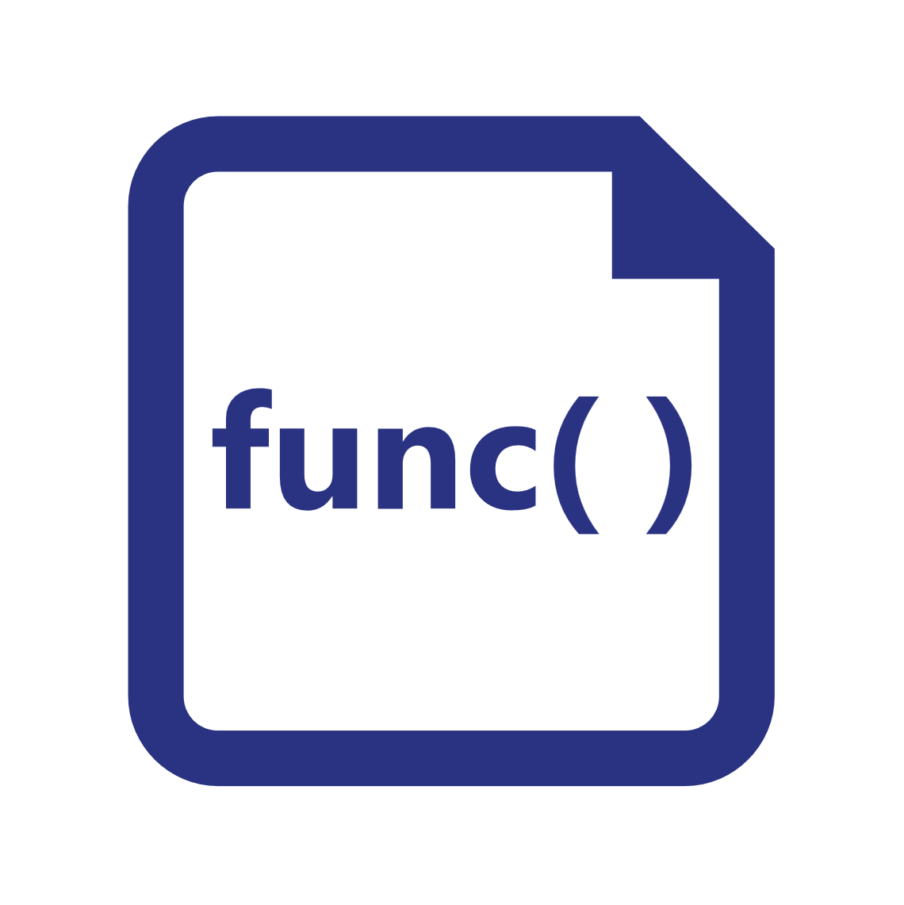




Functions everywhere
https://github.com/azure/azure-functions-host
(+other repos)
Azure Functions host runtime
Azure Functions Core Tools
Azure Functions base Docker image
Azure Functions .NET Docker image
Azure Functions Node Docker image
●●●
Development
Hosting
Local dev machine
Azure Functions
service
Azure Functions
service
Azure Functions service
IoT devices
Additional Azure hosts
Non-Azure hosts / on-premises
Non-Azure hosts / on-premises
Platform
+
●●●
●●●
●●●
Core Tools + favorite editor
Consumption plan
Premium plan
Premium plan
App Service plan
Azure IoT Edge
AKS, Container Apps, …
K8s, raw VMs, & more
App Service on Azure Stack
Application delivery
Code or container
Code
Code or container
Code or container
Container
Container
Container
Code
Operating system
Windows, macOS, or Linux
Windows or Linux
Windows or Linux
Windows or Linux
Linux
Linux
Linux
Windows
Notes:
Functions is open source – runtime, core tools, docker images.
Run it locally, its exactly what you see in the cloud. Very easy to get going and publish.
Publish to Azure Functions services – consumption, app service, and premium (best of both worlds)
Because the Functions host can run in a container, that makes your functions run anywhere where you can run a container – on a Pi, in AKS, or even in another cloud …
There is also other places to run functions – Raspberry Pi, Kubernetes cluster, or on non-azure hosts and on-prem.

Slide 8
Language support
C#
JavaScript / TypeScript
Java
Python
PowerShell
Other/Any
Notes:
All other languages used isolated process from version 2 of the runtime
.NET was the only one that was kept in the process for performance reasons – and also because functions host is .NET so it was easy to integrate.
From now on we’ll be focusing on the .NET runtime as it is the one that is changing!

Slide 9
Azure Functions .NET Roadmap (~2021)
.NET 5
.NET 6 ^{LTS}
.NET 7
.NET 8 ^{LTS}
Isolated process
Nov 2022
Nov 2023
Nov 2021
In-process
.NET Core 3.1 ^{LTS}
.NET 6 ^{LTS}
with Durable Functions
Notes:
If you’re using the in-process model, you can continue to use this for a while its supported on LTS branch, but as you can see all new .NET versions will be targeting the isolated process.

Slide 10
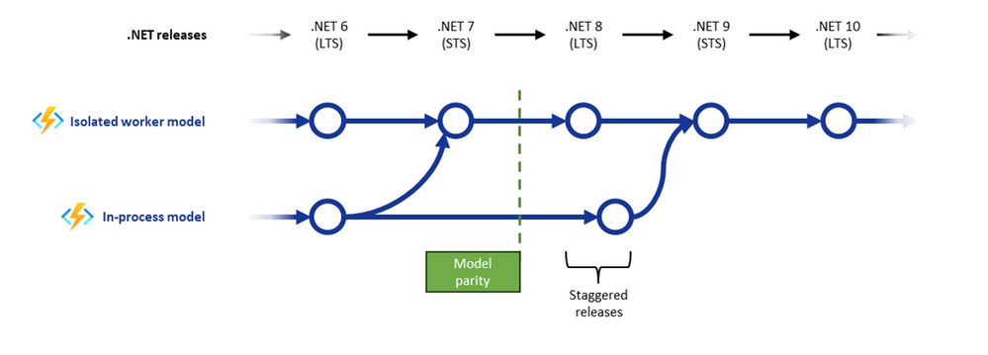
Azure Functions .NET Roadmap (2023 revision)
Jun-Jul 2024
Notes:
If you’re using the in-process model, you can continue to use this for a while its supported on LTS branch, but as you can see all new .NET versions will be targeting the isolated process. https://techcommunity.microsoft.com/t5/apps-on-azure-blog/net-on-azure-functions-march-2024-roadmap-update/ba-p/4097744
https://techcommunity.microsoft.com/t5/apps-on-azure-blog/net-on-azure-functions-september-2024-roadmap-update/ba-p/4246585
https://github.com/Azure/azure-functions-host/issues/9951
With .NET 6 support ending in Nov 2024 the team realized the upgrade path from 6->8 was much more complicated since most .NET 6 functions run in process. They decided to release one more runtime as in-process to allow customers for smoother migration
The 6-8 in process migration is smooth with no breaking changes. Allows customers to go to 8 in proc with no friction and then move from 8 in proc to 8 isolated before final deadline of support Nov 2026.

Slide 11

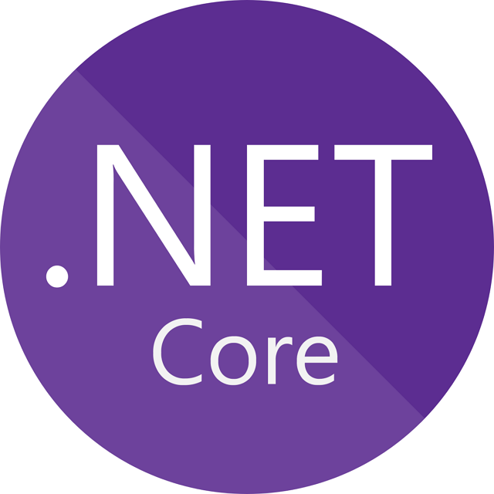




How do functions work (in-process model)
Host Process
Worker Code
Triggers
IPC
Input Bindings
Output bindings
This Photo by Unknown Author is licensed under CC BY-SA
Notes:
Some notes
IPC communication allows for complex objects / calls
.NET version is pinned to the host
Conclusions:
Worker runs inside the host which means:
Same dotnet version
Shared dependencies
Fast “startup”
Instant inter proc communication

Slide 12


What is isolated?
Host Process
Triggers
Worker Process
Input Bindings
Output bindings
This Photo by Unknown Author is licensed under CC BY-SA
Notes:
Azure Functions Extensibility - Extensions and Isolated Worker Model (tpeczek.com)
https://www.tpeczek.com/2024/03/azure-functions-extensibility.html
https://github.com/Azure/azure-functions-dotnet-worker/wiki/.NET-Worker-bindings
.net is the only runtime that had the in-process model.
Fewer conflicts: Assemblies used in your app won't conflict with different version of the same assemblies used by the host process.
Full control of the process: You control the start-up of the app and can control the configurations used and the middleware started.
Dependency injection: Use current .NET behaviors for dependency injection and incorporating middleware into your function app.
Target new versions: Easily target new versions of .NET as they become available.

Slide 13
Why the move?
Enhanced Isolation: Running functions in a separate process provides better isolation, reducing the risk of conflicts and improving overall reliability.
Custom Dependencies: The isolated model allows you to use custom dependencies and versions of .NET independently of the Azure Functions host, providing greater flexibility1.
Improved Security: By isolating the function code from the host process, the isolated worker model enhances security and reduces the attack surface1.
Better Resource Management: The isolated model allows for better resource management and scaling, as each function runs in its own process1.
Versioning freedom: You can target a different dotnet runtime than the host.

Slide 14
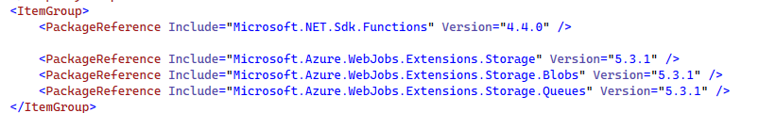
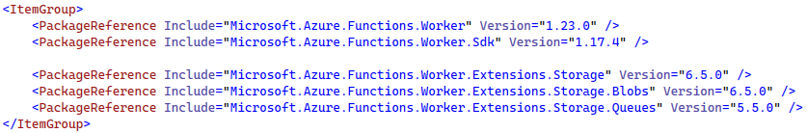
Key differences - Packages
In Process Model
Isolated model

Slide 15
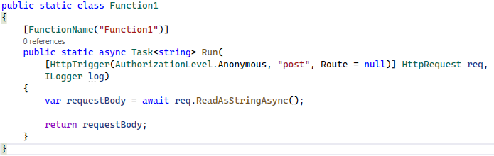
Key differences - Startup
In-Process
Notes:
The startup model is totally different even though it looks similar.
The In-Process model can be very simple – you just write EXACTLY just the function code and everything works – this is because as we seen before, the in-process model simply injects your code into a pre-existing .Net process (the host) and the runtime takes care of hooking it all up.
From that perspective, what you write as your function is literally just your function. You can see, your function is a static piece of code and that’s it.
One good example of this is the presence of the Ilogger- where is that coming from? Well, it’s probably part of the host process and it can get injected transparently. The function will work with or without it. While convenient, it’s a bit opaque – you have to know you can do that, and you don’t know what other “Services” are available to you.
Let’s say your function needs to execute some business logic that is available in one of your libraries, how do you “inject” or construct that in your function? Or maybe simpler to explain, how do you get an HttpClient in your function?

Slide 16
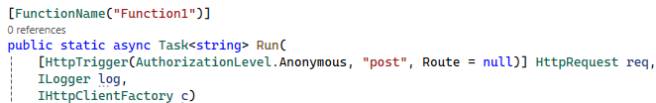
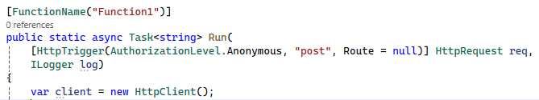

Key differences - Startup
In-Process
Notes:
Let’s say your function needs to execute some business logic that is available in one of your libraries, how do you “inject” or construct that in your function? Or maybe simpler to explain, how do you get an HttpClient in your function?
You might think, okay, let me inject that HttpClient just like Ilogger…unfortunately that doesn’t work…
Or you might say, okay, I can just create my client and be done with that – but we all know that is not good…. Right…. We know that….. If you don’t know why that’s not ideal, we can chat offline ☺

Slide 17
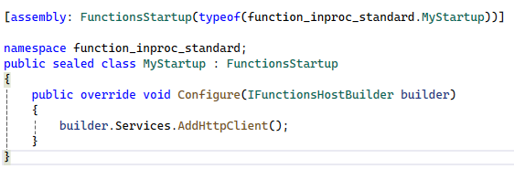
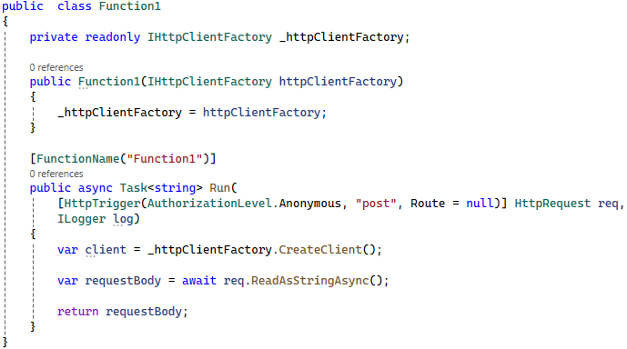
Key differences - Startup
In-Process
MyStartup.cs
Notes:
So really the solution here is to somehow get my Client Factory into a Services container so I can use it.
But my function is just a piece of code, how do I get stuff into the higher level host?
There is a way to do that – you need to hook into the startup process of the host itself. You an add all the services you want.
With that hook complete, we need to update our function to “read” from the container – we will still not be able to just inject the newly minted Factory into the Function code directly
We take the function class and add that in the constructor- where injection will work.

Slide 18
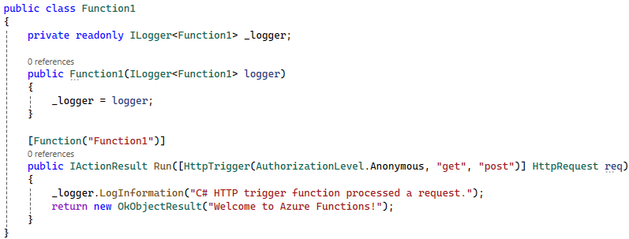
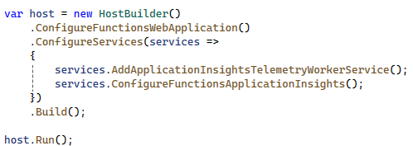
Key differences - Startup
Isolated
Program.cs
Notes:
So now, as you will see the startup lifecycle and flow of the Isolated functions is both similar and different than the In proc
On one hand, the bare minimum standard function looks very similar to the “end-state” of the full-fledged function, but the way to get there is a bit different.
In the isolated model, the code that you write, is a full-fledged ASP NET Core App and it looks and behaves very similar to that. It gives you the power to configure things exactly how you like but it will take a bit longer to spin up.

Slide 19
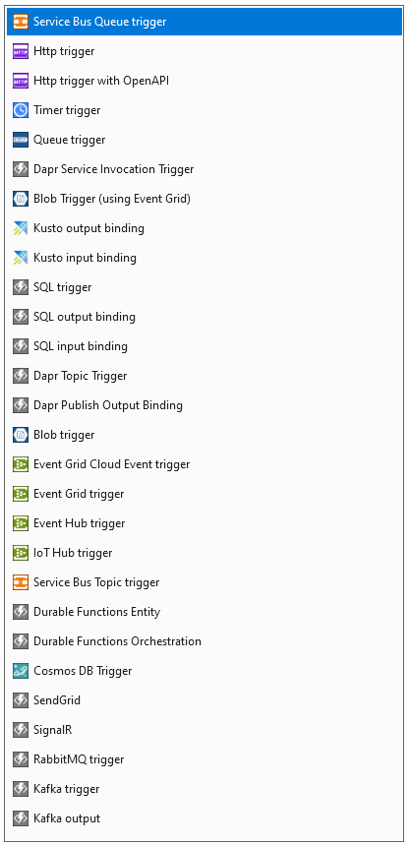
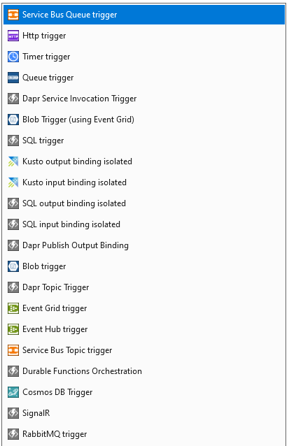
Key differences - Bindings
In-Process
Isolated

Slide 20
Save images from the internet what can go wrong ? ☺
Migration Scenario
Save URL to Queue
Save original image to Blob
Resize and save final image
HTTP Trigger
Queue
Trigger
Blob
Trigger
Queue
output
Blob
output
Blob
output
Get image
HTTP Trigger
Blob
input
Notes:
There are a few more differences than just availability of bindings, driven by the fundamental difference in which the host talks to your code/
Best to go though them with an example and demo
What can go wrong? Let’s say we want to make sure the images are okay for us to save, and they are of a consistent size

Slide 21

Demo

Slide 22
Conclusion
Isolated mode provides better future proofing of your function with support beyond 2026
Apart from the minor initial config (NuGet, Program.cs) most of the work will be in updating the bindings
Follow the Migration Planner doc for guidance if needed.

Slide 23

Questions

